Slide 1
Introduction to Parallel Processing
Why are parallel computers needed?
  Large-scale numerical applications typically are highly structured computations.
  A conventional high-performance machine will take years to run some very large programs. For example, some programs require 10¹² to 10¹⁵ floating-point operations to achieve solutions at the desired level of accuracy. One year only has approximately 3.15 x 10¹³ microseconds. A conventional high-performance machine can complete roughly one floating-point operation per microsecond.
  The speed of light is already a major problem for designers of high-end computers.
  The heat-dissipation problem for supercomputers is already a very serious problem.
  To solve large-scale numerical problems, an architecture almost certainly must have a large amount of parallelism, and it must exploit the particular characteristics of the problem.
Notes:
There are various ways to do things faster and faster. One way is to speed up by increasing the clock speed. However there is a limit you can go using existing technology. So until the day we are able to move to a new platform, we are pretty much at the limit of the clock speed. The second way is to look at the optimality of software and compilers. This approach will not be covered in this course. The third way is to look at do things in parallel. This will be covered in this section.

Slide 2
Overview of Parallel Computers
Parallel computers are special purpose computers. Three application examples:
  Parallel computers are designed to run multiple independent jobs simultaneously. These jobs have nothing to do with one another and do not communicate. A typical example is a big UNIX time-sharing system for handling a few hundred users at remote terminals.
  Parallel computer used for running a single job consisting of many parallel processes.
  Parallel computer used for running a single job consisting of many parallel computations. Pipelined computers, vector supercomputers and array processors can be used.

Slide 3
Coupling
Loosely coupled
  system with a small number of independent CPUs that have low bandwidth connections between the CPUs
  A LAN for example connecting computers of different makes together
Tightly coupled
  are smaller and closer together
  normally contains the same type of CPUs
  interact frequently over high bandwidth communication networks
  possibly share common memory

Slide 4
Classification of parallel computers
(Flynn, 1972)
SISD is the classical, sequential von Neumann computer.
SIMD machines have a single control unit that executes one instruction at a time, but they have multiple ALUs to carry out that instruction on multiple data set simultaneously.
  Examples: Vector supercomputers and array processors.
MISD: Multiple instructions operating on the same piece of data.
  Pipelined machines?
MIMD: Multiple independent CPUs operating as part of a large system.
  Example: Transputer system.

Slide 5
Interconnection Networks - topology
Networks with constant communication time
  Bus: Single bus or Multibus
  Star
  Full Crossbar
  Full interconnection
Networks with variable communication time
  Linear or Ring
  Tree
  Mesh (Nearest-neighbor)
  Staged networks
  Hypercube
Notes:
We will next look at the various ways CPU can be connected together. The above lists some of the network topologies. We will examine them in term of a few key parameters.

Slide 6
Terminology
Communication diameter
  number of nodes through which a message must travel to reach its destination
Expandability
  number of component and connections required for adding a node
  cost factor
Redundancy
  number of different paths from source to destination
  how many defective node do we allow?
Routing
  how do address information from source to destination
  depends on network uniformity
Bandwidth
  amount of data that can be sent over in unit time
Network latency
  time for a message to pass through
  package switching has different time for different messages
Connection Degree
  number of pathways leaving a node

Slide 7
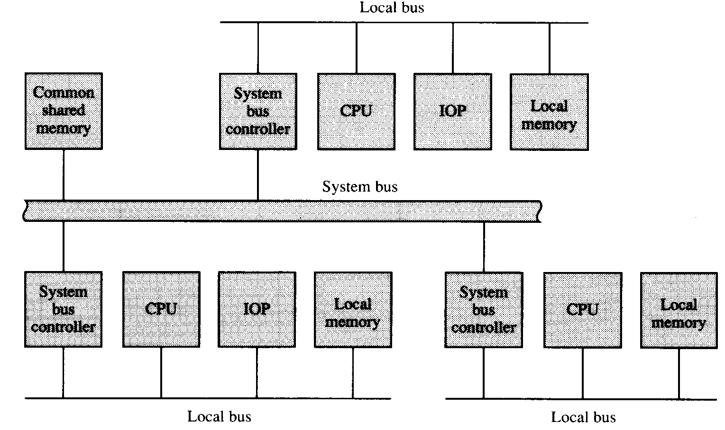
Bus: Single bus and multi-bus
Communication diameter (minimum latency for unit data transfer): 1
Expandability (wiring & switching complexity): Fixed cost
Redundancy: Depend on the number of buses
Routing: Easy (Addressing)
Bandwidth: Limited
Network latency: High for a large number of processors
Connection Degree: n
Tap structure (Single link to the network): Yes
System size (Maximum number of processors): Small (2 to 16)
Cheap. Suitable for small
multi-processor system.
Multi-bus: example
Motorola DSP96002, has
2 address/data buses,
enable the CPU to talk
to 2 devices at the same
time

Slide 8
Example: DVP platform
MEMORY
PRXXXX CPU
Memory
Interface
TM-X CPU
PRXXXX
MIPS core
TM- X core Trimedia
D$
I$
D$
I$
Device 1
Device 1
Device 2
DVP-memory bus
Device 2
...
...
Device n
Device n
PIO bus = PI-bus
PIO bus = PI-bus
Bridge
DVP-based IC

Slide 9
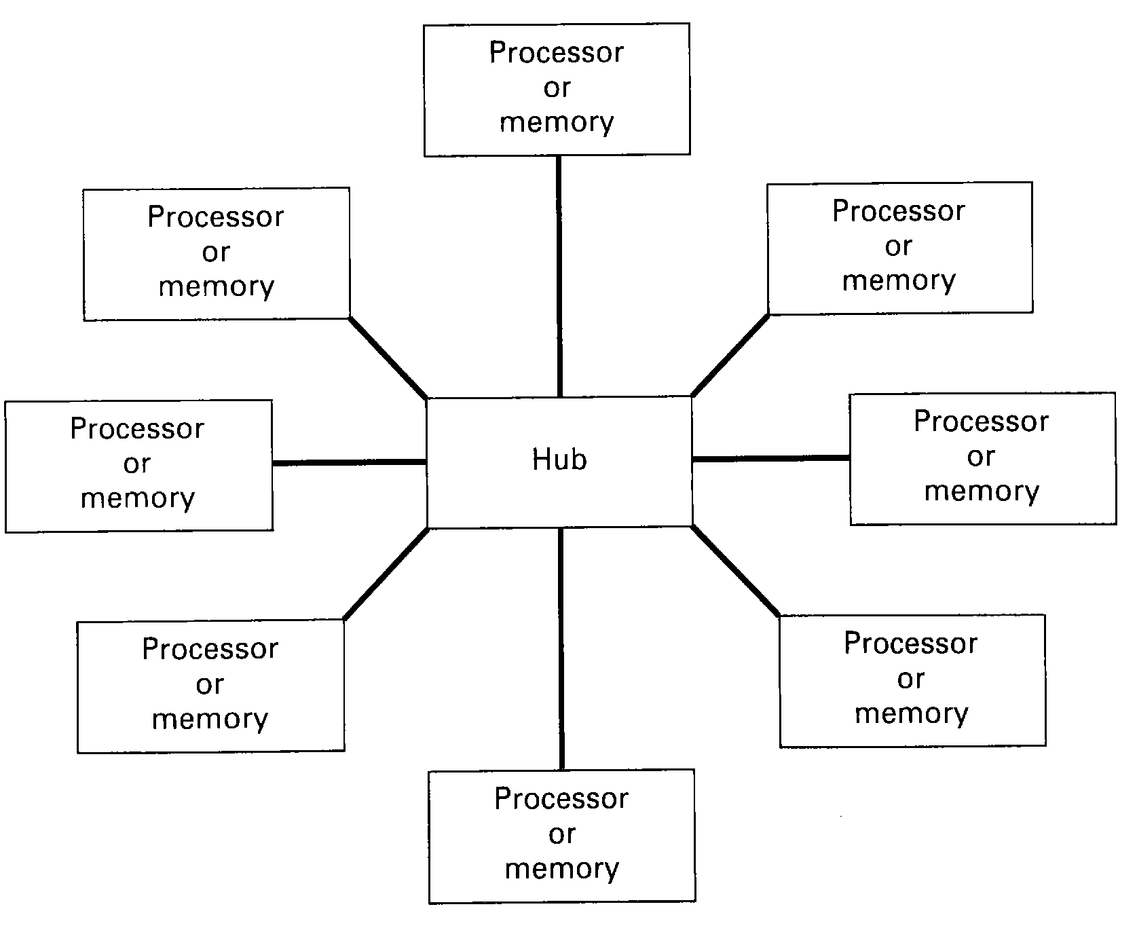
Star
Communication diameter: 2
Expandability: Fixed cost
Redundancy: Hub should never be faulty. The other n nodes will not affect network communication as much as the hub.
Routing: Easy (Direct connection)
Bandwidth: High
Network latency: Fixed and small
Connection Degree: Depending on the hub
Tap structure: Yes
System size (Maximum number of processors): Small

Slide 10
From busses to concentrators to ...
Extern
SDRAM
m
ICP+MMI
e
m
CAB
VMPG
_
Video
k
l
clk_mem
c
uclocks
1394
T-PI
C-Access
clk_mem
clk_tstamp
clk_tpi
UVMSP3
clk_tpi_utm_3218
clk_mem_utm_3218
C1
C4
C5
C8
C9
C12
C13
C16
clk_mips
clk_fpi
TM32
C2
C3
C6
C7
C10
C11
C14
C15
PR3940
clk_mpi
embedded cores
M-PI

Slide 11
Issues
architecture
  the limit of scalability of buses is reached
  communication via central memory doubles the bandwidth
programming (software) issues
  synchronization via central CPU leads to core grain tasks
  scheduling of central resources (bus and memory) is difficult and time consuming specially for real-time applications
VLSI (hardware) issues
  interconnect delay dominates the gate delay which leads
  to multi-hop communication
  clocking

Slide 12
Networks-on-Silicon
Extern
SDRAM
Hierarchical architecture with clusters of processors and memories, autonomously operating and cooperating via an on-chip network with routers, segmented interconnect and distributed memories
C1
C4
C5
C8
C9
C12
C13
C16
C2
C3
C6
C7
C10
C11
C14
C15
embedded cores
+ embedded memories

Slide 13
Networks-on-Silicon
C1
C4
C5
C8
C9
C12
C13
C16
C2
C3
C6
C7
C10
C11
C14
C15

Slide 14
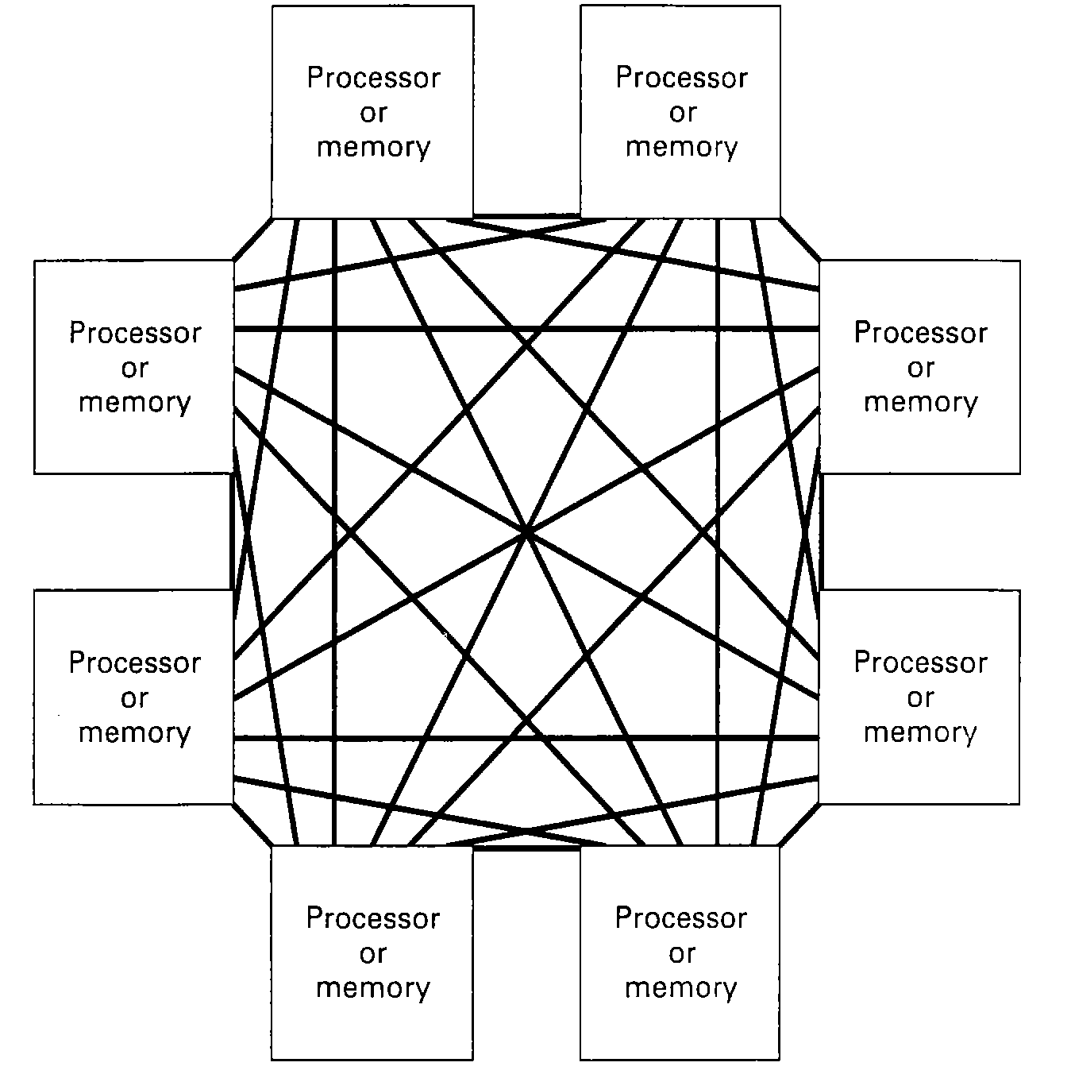
Full Interconnection (Complete Interconnection)
Cost is prohibitive
Normally size is limited because each
processor has a limited number of ports
Communication diameter: 1
Expandability: High cost, a function of node number. (If present node number is n, an added node to the network would result in n additional links.)
Redundancy: High
Routing: Easy (Direct connection)
Bandwidth: High
Network latency: Small
Connection Degree: n - 1, where n is the number of nodes.
Tap structure: No. (There are n - 1 connections.)
System size (Max number of processors): small
Total number of links: (n x (n-1)) / 2

Slide 15
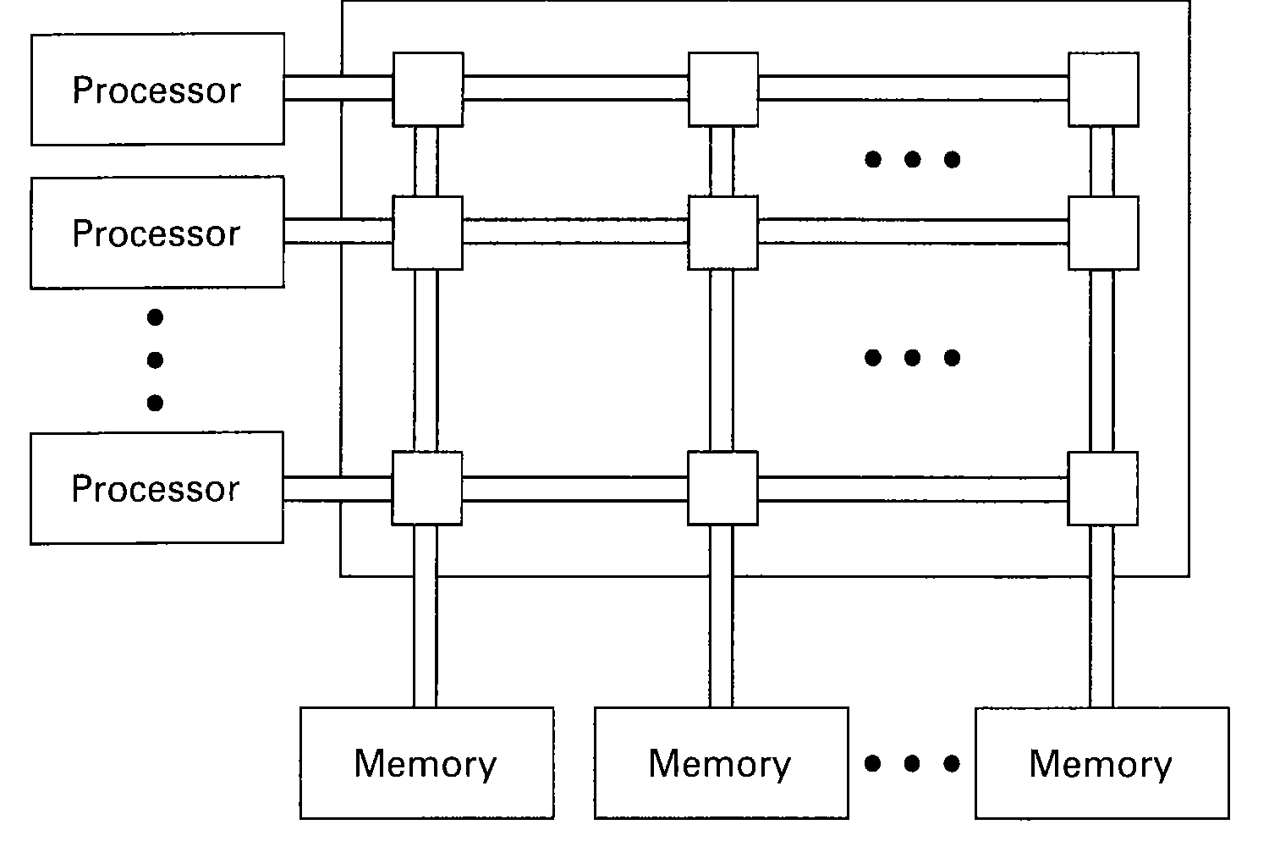
Full Crossbar
Communication diameter: 1
Expandability: Number of switches = p x m, where p is the number of processors and m is the number of memory banks.
Redundancy: A faulty switch only affects the connection between a single CPU-memory pair.
Routing: Easy (Destination address can be used for setting switches.)
Bandwidth: High (Nonblocking)
Network latency: Small
Connection Degree: From a processor: m. From a memory bank: p.
Tap structure: Yes
System size (Maximum number of processors): Small
Each switch can
have hundreds of
connections

Slide 16
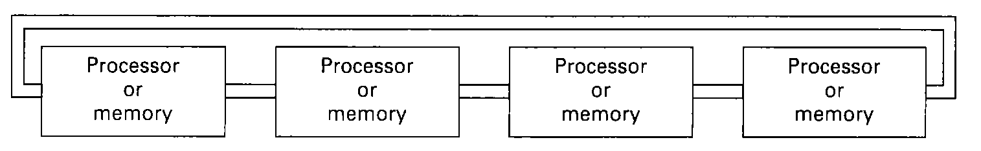
Linear or Ring
Communication diameter:
  Linear: Max: n - 1, Min: 1, Average: n / 2
  Ring: Max: n / 2, Min: 1, Average: n / 4
Expandability: Fixed cost
Redundancy: Low unless the nodes are fault-tolerant nodes.
Routing: Easy (Only two directions)
Bandwidth: Depending on the application
Network latency: Depending on the distance between the nodes
Connection Degree: 2
Tap structure: No. (2 connections.)
System size (Maximum number of processors): Small to Medium
Possibly a dual port memory

Slide 17
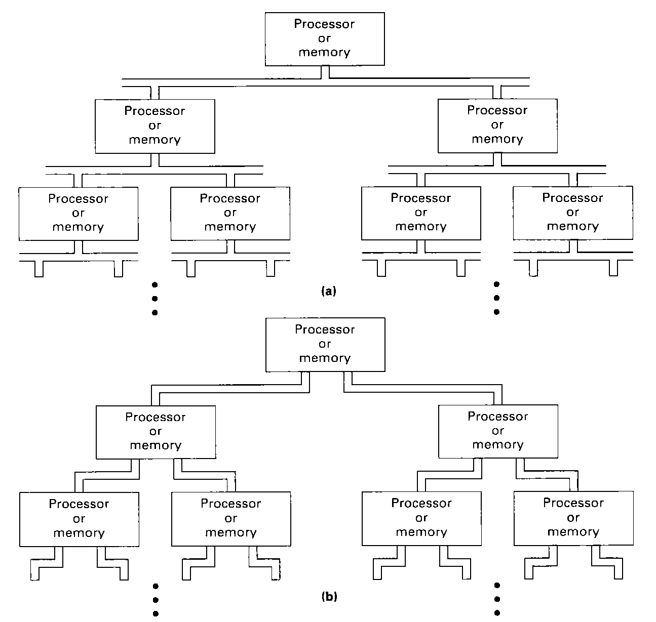
Tree
Communication diameter: Max: 2 x(number of levels - 1), Min: 1
Expandability: Fixed cost
Redundancy: Low
Routing: Binary address of each node can be use for routing in a binary tree.
Bandwidth: Depending on the application
Network latency: Depending on the distance between the nodes
Connection Degree: > 2
Tap structure: No. ( > 2 connections)
System size (Maximum number of processors): Medium to large
Degree 2
Degree 3

Slide 18
Mesh (Nearest Neighbor)
Communication diameter: Max: 2 x (n - 1), Min: 1, for a n x n network
Expandability: Depending on n
Redundancy: High
Routing: Multiple paths between nodes
Bandwidth: Depending on the application
Network latency: Depending on the distance between the nodes
Connection Degree: 4
Tap structure: No. (4 connections)
System size (Maximum number of processors): Medium to large
Processors occupy the intersections
of a 2-dimensional grid
2 processors are connected if they
are adjacent on the grid; left-right
or up-down
Suitable for array processor but
too difficult for general purpose
processors

Slide 19
Staged Networks
Communication diameter: Depending on number of stages
Expandability: High, depending on number of nodes
Redundancy: Depending on number of stages
Routing: Easy for networks which has no multiple paths between nodes
Bandwidth: Low for blocking networks
Network latency: Depending on the number of stages
Connection Degree: Depending on the network
Tap structure: Yes
System size (Maximum number of processors): Small to Medium
Use multiple switching elements
between inputs and outputs
Can be circuit or packet switched
Useful for pipeline processors
General use small cross bus
Cost:
An NxN crossbar requires N^2
components.
Staged network requires N log N
components

Slide 20
Staged Networks
  Crossbar switches: From 2 x 2 to 8 x 8
Multiples of these switches
are combined to provide
the overall N to N
connections.
Inputs
Outputs
Straight-through connection
Cross connection (Exchange)
A full crossbar can
simultaneously make
any set of connections,
the staged network
generally cannot
Lower broadcast
Upper broadcast

Slide 21
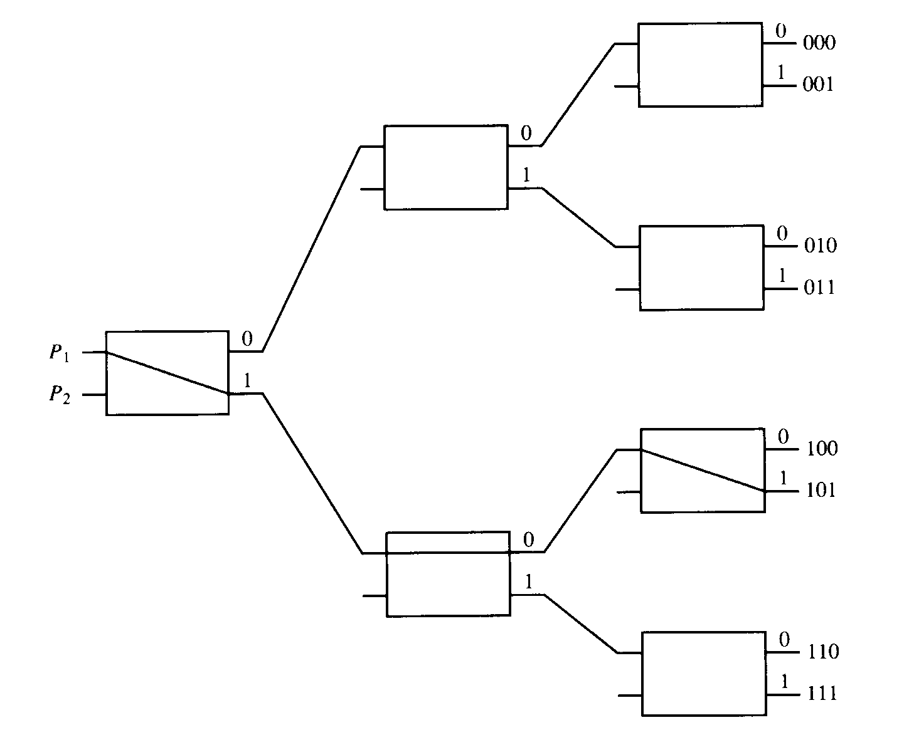
Example of a binary tree with 2 x 2 switches
2 processors to 8 memory blocks.
Path from source to destination
is determined from the binary
bits of the destination number.
If P1 is connected to one of
destinations 000 to 011,
then P2 can be connected to
one of destinations 100 to 111.

Slide 22
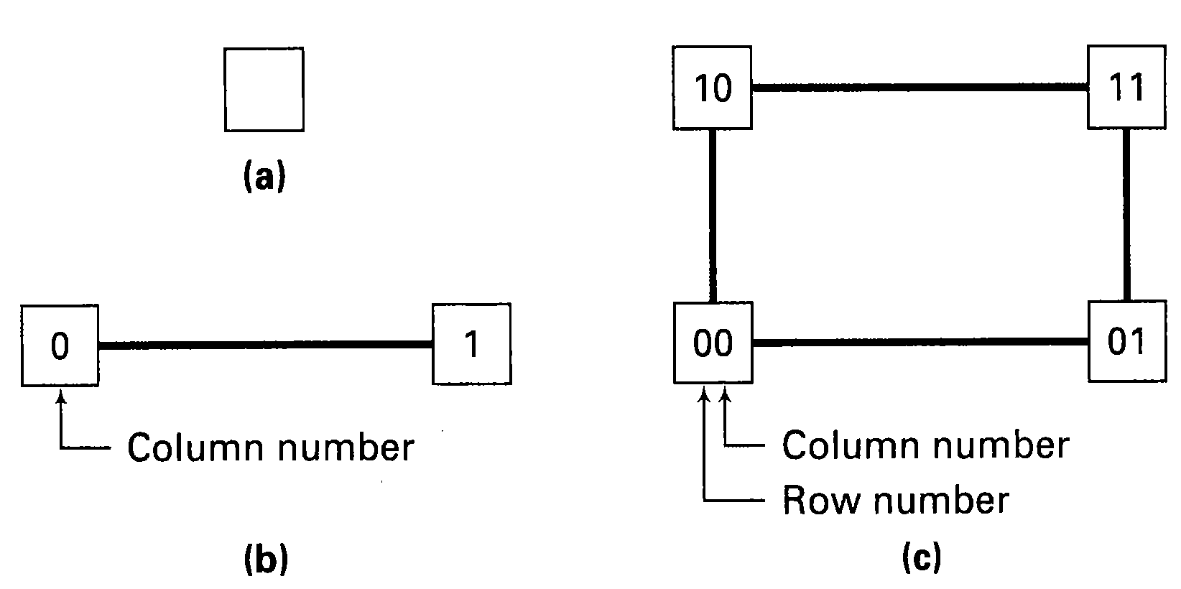
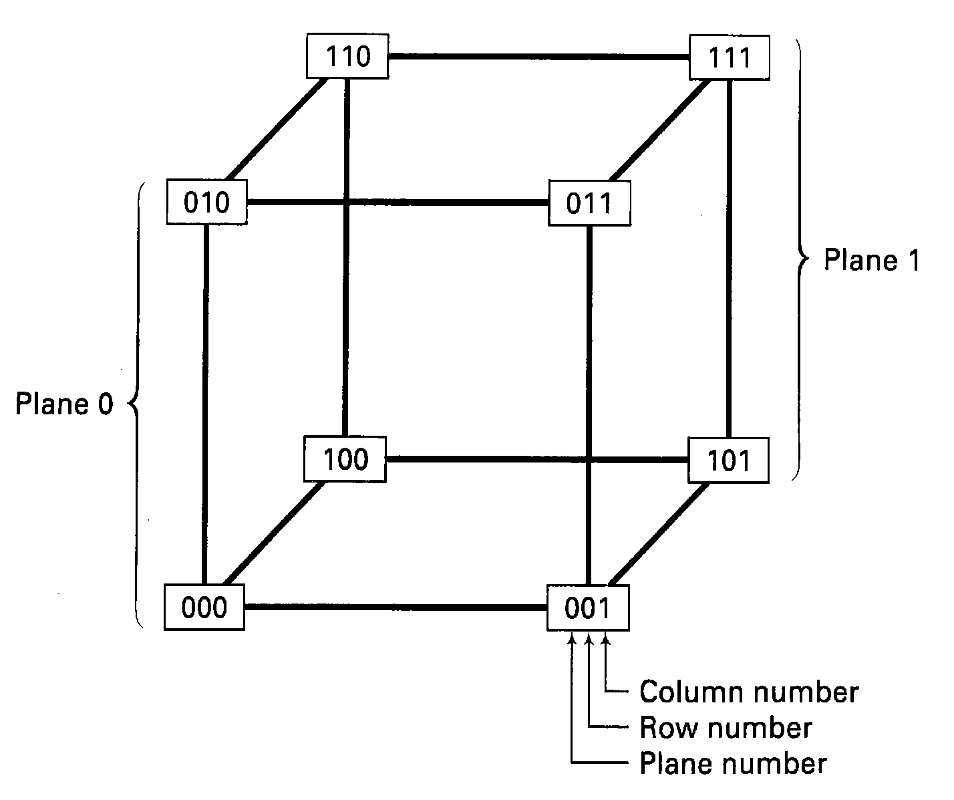
Hypercube
Communication diameter: Max: n, Min: 1,
  Average: (n x 2^{n-1}) / (2^{n} - 1),
  where n is the dimension of the hypercube and 2^{n} is the number of nodes.
Expandability: High, depending on the dimension
Redundancy: High
Routing: Easy. Method: Exclusive OR of the source and destination addresses. There are multiple paths.
Bandwidth: High
Network latency: Depending on the distance between nodes
Connection Degree: n
Tap structure: No. (n connections)
System size (Maximum number of processors): Small to Medium

Slide 23
SIMD Architectures
Control unit
Types
  Associative processors
  Processor arrays
  Hypercube machines
. . .
PE
PE
PE
PE
PE
. . .
M
M
M
M
M
The control unit broadcasts Instructions to all PEs.
The PEs operate in lock-step fashion, each performing the same operation on their own data.

Slide 24
Intel Streaming SIMD Extensions
The Streaming SIMD Extensions adds
  8 new 128-bit SIMD floating-point registers that can be directly addressed;
  50 new instructions that work on packed floating-point data;
  8 new instructions designed to control cache-ability of all MMX and 32-bit x86 data types, including the ability to stream data to memory without polluting the caches, and to prefetch data before it is actually used;
  12 new instructions that extend the MMX instruction set.
Enables the programmer to develop algorithms that can mix packed, single-precision, floating-point and integer using both SSE and MMX instructions respectively.
This approach was chosen because most media processing applications have the following characteristics:
  inherently parallel
  wide dynamic range, hence floating-point based
  regular memory access patterns
  data independent control flow.

Slide 25
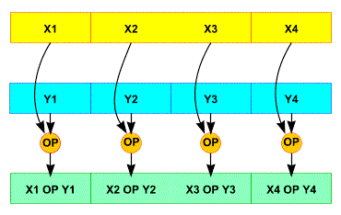
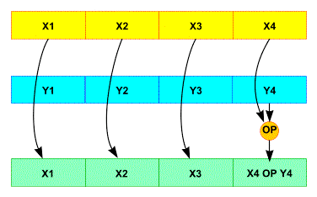
SIMD Operations
SSE Packed
SSE Scalar
Intel SSE provides eight 128-bit general-purpose registers,
  each of which can be directly addressed using the register names XMM0 to XMM7.
  Each register consists of four 32-bit single precision, floating-point numbers, numbered 0 through 3.

Slide 26
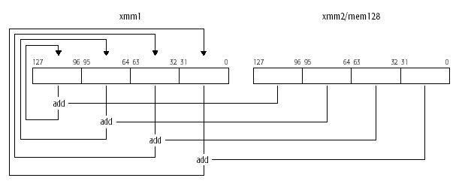
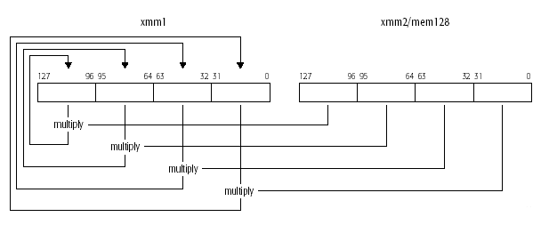
Parallel Operations
ADDPS __m128 _mm_add_ps(__m128 a, __m128 b)
DEST[31-0] ← DEST[31-0] + SRC[31-0];
DEST[63-32] ← DEST[63-32] + SRC[63-32];
DEST[95-64] ← DEST[95-64] + SRC[95-64];
DEST[127-96] ← DEST[127-96] + SRC[127-96];
MULPS __m128 _mm_mul_ps(__m128 a, __m128 b)
DEST[31-0] ← DEST[31-0] * SRC[31-0];
DEST[63-32] ← DEST[63-32] * SRC[63-32];
DEST[95-64] ← DEST[95-64] * SRC[95-64];
DEST[127-96] ← DEST[127-96] * SRC[127-96];

Slide 27
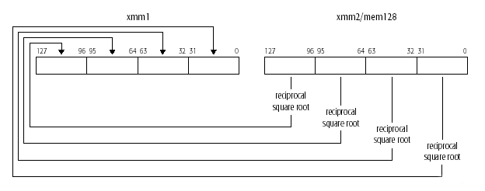
Example: RSQRTPS xmm1, xmm2/m128
Performs a SIMD computation of the approximate reciprocals of the square roots of the
four packed single-precision floating-point values in the source operand (second operand)
and stores the packed single-precision floating-point results in the destination operand. The
source operand can be an XMM register or a 128-bit memory location. The destination
operand is an XMM register.
DEST[31-0] ← APPROXIMATE(1.0/SQRT(SRC[31-0]));
DEST[63-32] ← APPROXIMATE(1.0/SQRT(SRC[63-32]));
DEST[95-64] ← APPROXIMATE(1.0/SQRT(SRC[95-64]));
DEST[127-96] ← APPROXIMATE(1.0/SQRT(SRC[127-96]));

Slide 28
Categories of SSE instructions
Data movement instructions
Arithmetic instructions
Reciprocal instructions
Comparison instructions
Conversion instructions
Logical instructions
Additional SIMD integer instructions (SSE Primer)
Shuffle instructions
State Management instructions
Cacheability Control instructions

Slide 29
MIMD Machines
  MIMD Architectures
  Bus-Based MIMD Shared-Memory Multiprocessors
  Cache Coherence
  Multistage MIMD Shared-Memory Multiprocessors
  Message-Passing Multiprocessor Systems
Scope

Slide 30
MIMD Architectures
An MIMD (Multiple Instruction stream and Multiple Data stream) machine is a multiprocessor where each processor has its own control unit and executes its own program.
  GM-MIMD (Shared-memory multiprocessor)
    Tightly coupled multiprocessor.
    Processors share a single global memory.
    CPU-memory interconnection:
    Bus or other interconnection networks
  LM-MIMD (Disjoint-memory multiprocessor)
    Loosely coupled multiprocessor.
    Each processor has its own local memory.
    Processors communicate by message passing.
    Processor-processor interconnection:
      Bus or other interconnection networks

Slide 31
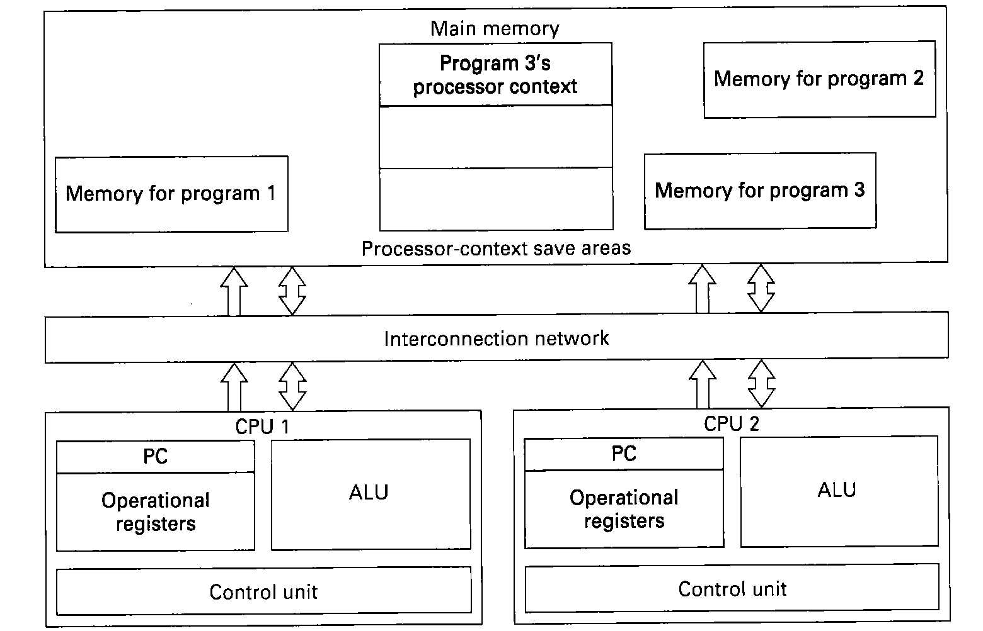
Running processes on MIMD processor
For processes that do not spawn subprocesses
  use CPUs as simple set of computational resources
For processes that spawn subprocesses
  subprocesses may be assigned to other CPU
  need synchronization
All memory accessible to both processors
  one CPU executes one program
  non-executing programs are suspended

Slide 32
MIMD Architectures
Multiprocessor Systems must provide support facilities for the following task-management capabilities.
  1. Process initiation (process generation and activation)
    to be able to spawn other processes
  2. Process synchronization
    to be able to suspend itself or another process until some “external” event occurs. May be a slower process.
  3. Process exclusion for shared resources
    to be able to monopolise a resource such as code or data
  4. Process communication (message passing and broadcasting)
    to be able to send messages to other process and receive message from them
  5. Process termination
    to be able to terminate oneself or other to free up resources

Slide 33
Bus-Based MIMD Shared-Memory Multiprocessors
(a) The simplest approach has a very busy bus.
CPU
CPU
CPU
Memory
Bus
(b) If the cache achieves 90 percent hit rate, the bus traffic will be cut by a factor of 10, making systems with 16 to 32 processors feasible.
CPU
CPU
CPU
Cache
Cache
Cache
Memory
Bus

Slide 34
Bus-Based MIMD Shared-Memory Multiprocessors
(c) Keeping Private data (such as code and stack) in the private memory will reduce the bus traffic for code, the stack and local variables to zero. But this approach makes it difficult for the processors to access the data in the private memories of the others.
LM
LM
LM
CPU
CPU
CPU
Cache
Cache
Cache
Memory
Bus

Slide 35
Bus-Based MIMD Shared-Memory Multiprocessors
(d) Each on-board memory can be directly accessed by its own CPU, without going over the bus, but other CPUs can also get at it remotely.
CPU
LM
CPU
LM
Cache
Cache
Memory
Bus
If the shared memory is a multiple-module memory
  Shared memory can be designed as a multiple-module memory system. After a CPU sends a request to a memory module, it can release the bus and let other CPUs use it. When the memory is finally ready to respond, it acquires the bus itself and replies. This method makes better use of the bus bandwidth by pipelining multiple requests to the memory system.

Slide 36
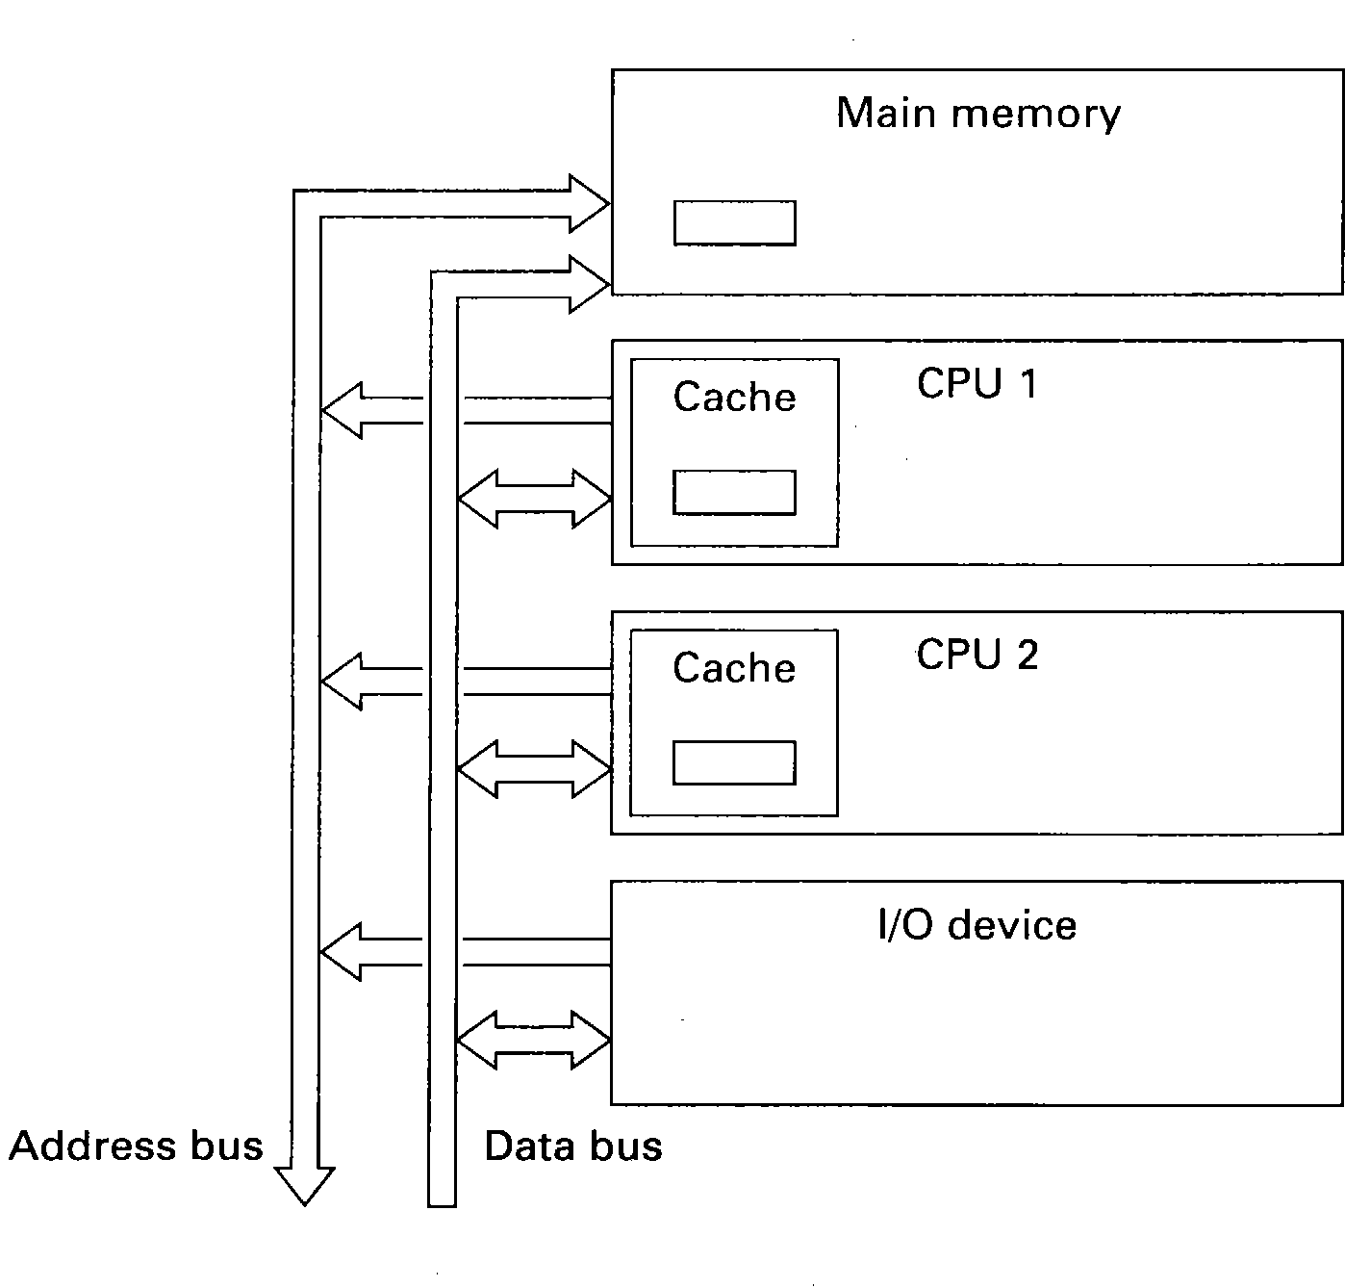
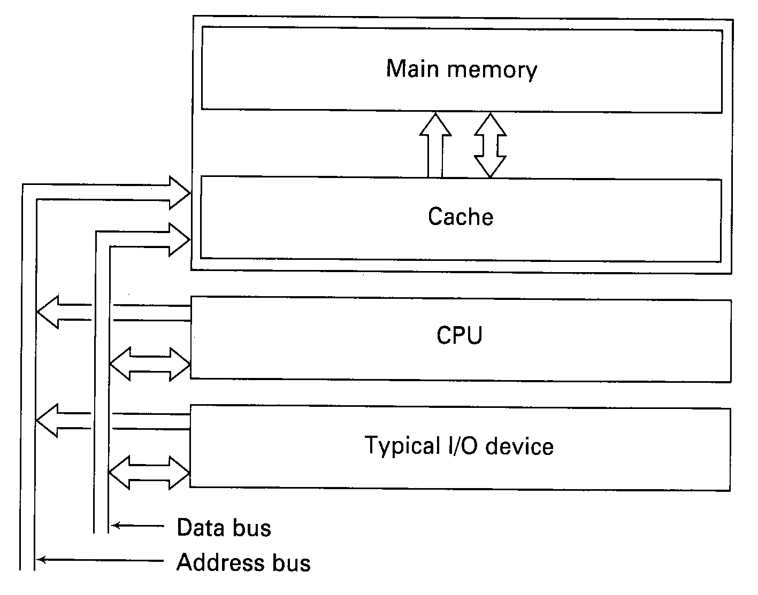
Cache Coherence
Cache coherence (Data consistency) problem
  In shared memory multiprocessor system, if two processors have their own caches for the memory, it is possible for one processor to be unaware of the change in the value of the data made by the other processor (the change has yet to be forced out of the cache). Only shared data that is write-able can cause cache coherence problems.
With possible of 3 copies, one or two of them may be stale
All accesses go through cache, so neither the memory nor the cache
ever has stale data

Slide 37
Software solutions:
The system writes values to all caches and to main memory at the same time whenever any write operation occurs.
The system invalidates cache entries that hold potentially corrupted or stale data by flushing the cache when switching process context.
The compiler could allocate shared write-able data in a special segment, page or part of the address space, say the first 16K of memory , that the hardware does not cache, or for which segment, caching is turned off by the software.
A software solution eliminates the cache coherence problem at the price of either disabling caching for shared, write-able data or adding a lot of unnecessary write operations. For applications that happen to make especially heavy use of shared write-able data, such as in some data base systems, this solution is inadequate.

Slide 38
Hardware solution:
One of the hardware solutions is called snooping cache or snoopy cache. This caching hardware snoops on the bus for hit/miss and read/write activity on the other caches and decides for itself if the current copy of the data in its own cache is stale and has to be synchronized.
  The set of rules implemented by the caches, CPUs and memory for preventing different versions of the same block from appearing in multiple caches is called the cache consistency protocol.
    (1) Write through protocol, and
    (2) Write once protocol.
Another solution used for set-associative cache is to use an invalidation bus, which broadcasts to all caches in the system the set number for each memory-write operation. Each cache then invalidates the corresponding set.

Slide 39
Write through protocol
On a read hit, the word is read from the local cache.
On a read miss, the block is loaded into the local cache
On a write hit, the local cache is updated and the word is written through to main memory in addition.
On a write miss, the word is written to main memory. The block containing the word is not loaded into the local cache.
  Both on write misses and on write hits from a processor, each of the other snooping caches checks to see if it has the word being written. If not, it does noting. Otherwise, it should either mark the cache entry containing the newly modified word as being invalid or update its cache.
  This protocol is inefficient. It eliminates the bus traffic on reads to shared write-able variables, but it does not eliminate the traffic on writes.

Slide 40
Write once protocol
The advantage of write once over write through is that if a CPU needs to make a large number of reads and writes in quick succession to a shared word, only the first write requires any bus traffic. Subsequent writes are handled internally.
Each cache block is in one of four states:
  INVALID -- This cache slot does not contain valid data.
  CLEAN -- Memory is up-to-date; block may be in other cache.
  RESERVED -- Memory is up-to-date; no other cache holds this block.
  DIRTY -- Memory is incorrect; no other cache holds this block.

Slide 41
Write once protocol
On a read hit, the word is read from the local cache.
On a read miss, a bus request is made and each of the other caches snoops on the bus to see if it has the entry. If nobody has the entry or one (or more) has the entry marked CLEAN, the originator goes to memory to fetch the block and mark it CLEAN. If one has the entry and the entry is marked DIRTY or RESERVED, it asserts a special bus signal to inhibit memory from replying, and provides the whole cache block to the requesting processor. Then the originator marks the entry as DIRTY, while the provider marks its entry as INVALID.
On a write hit, if the cache entry is DIRTY, it is updated. If the entry is RESERVED, it is made DIRTY. If it is CLEAN, the entry is updated with its state changed to RESERVED, and the word is written to memory. All the other caches containing the entry will change the state from CLEAN to INVALID.
On a write miss, the originator first loads the entry (read miss) and then write the word to the entry (write hit).

Slide 42
Multistage MIMD Shared-Memory Multiprocessors
Buses do not scale to large systems. Sixty-four processors is probably the practical limit for one bus.
The only practical way to implement a memory shared among a substantially large number of CPUs is to split the memory up into numerous modules and provide multiple paths between the CPUs and the memories.
Not only does this arrangement provide more bandwidth, but it also allows multiple requests to be handled in parallel.
An essential property is that the access time from every processor to every memory is the same.
The common connection topologies are crossbar switches, omega networks and other multistage interconnection networks.

Slide 43
Multistage MIMD Shared-Memory Multiprocessors: to note
It is desirable to spread the memory references uniformly across the modules. One common technique is to use the low-order bits as the module number. Consecutively addressed words will be in consecutive modules, i.e., the memory system is interleaved.
The problem of barrier synchronization occurs in many parallel applications. Suppose that the program has two phases, and no processes may enter the second phase until all processes have finished the first phase. The straightforward solution is to initialize a counter to the number of processes. When each process finished the first phase, it decrements the counter. When the counter gets to zero, everybody can start phase 2. If every finished processor is reading the counter in a tight loop while waiting for the last processor to finish the first phase, the module containing the counter would become a hot spot (bottleneck), slowing down the entire system.

Slide 44
Multistage MIMD Shared-Memory Multiprocessors
Comparison of bus-based shared-memory multiprocessors to those based on multistage interconnection networks
  The bus-based systems get most of their performance from snooping caches running complex cache coherence protocols. Multistage network systems get theirs by physically increasing the bandwidth via multiple paths and switches.
  Bus-based systems do not scale to hundreds or thousands of processors. Multistage network systems do scale to systems with several hundreds of nodes, but how much further they can go is an open issue. The main problem is the log₂n delay introduced by the multiple layers of switches. If the switches are simple, with no queuing and combining, then hot spots may form. If queuing and combining are used, then the switches need memory and begin to look like little microprocessors.

Slide 45
Message-passing Multiprocessor System
Disjoint-Memory MIMD Computers
  Each CPU has its own private memory. No memory is physically shared, so communication is done by message passing through communication channels.
Interconnection networks:
  A single communication channel shared by all computers. For example, a collection of workstations connected by a local-area network.
  A mesh interconnection has a number of undirectional links, hence the bandwidth and also the cost, proportional to 4n for large n. A linear growth in the cost as a function of size is usually acceptable, since the processor cost is also linear with n .
  A hypercube interconnection. For example, the iPSC/2 family from Intel.

Slide 46
Conclusions
Introduction
Logic design of a microprocessor
Supporting tools
Micro-programmed design of a microprocessor
Pipelining and RISC design
Memory organisation
Multiprocessor

